Slide 1
JUST-GREEN AFRH2ICA Innovation Platform
USER GUIDE

Slide 2

SUMMARY
01.
02.
03.
04.
05.
06.
07.
08.
09.
Log-in...................................................................................3
Registration........................................................................4
Homepage..........................................................................5
News ....................................................................................8
Document…………………….....................................................10
Events………………………..….....................................................12
Opportunities……................................................................14
Organizations.....................................................................16
Administration section.....................................................18

Slide 3
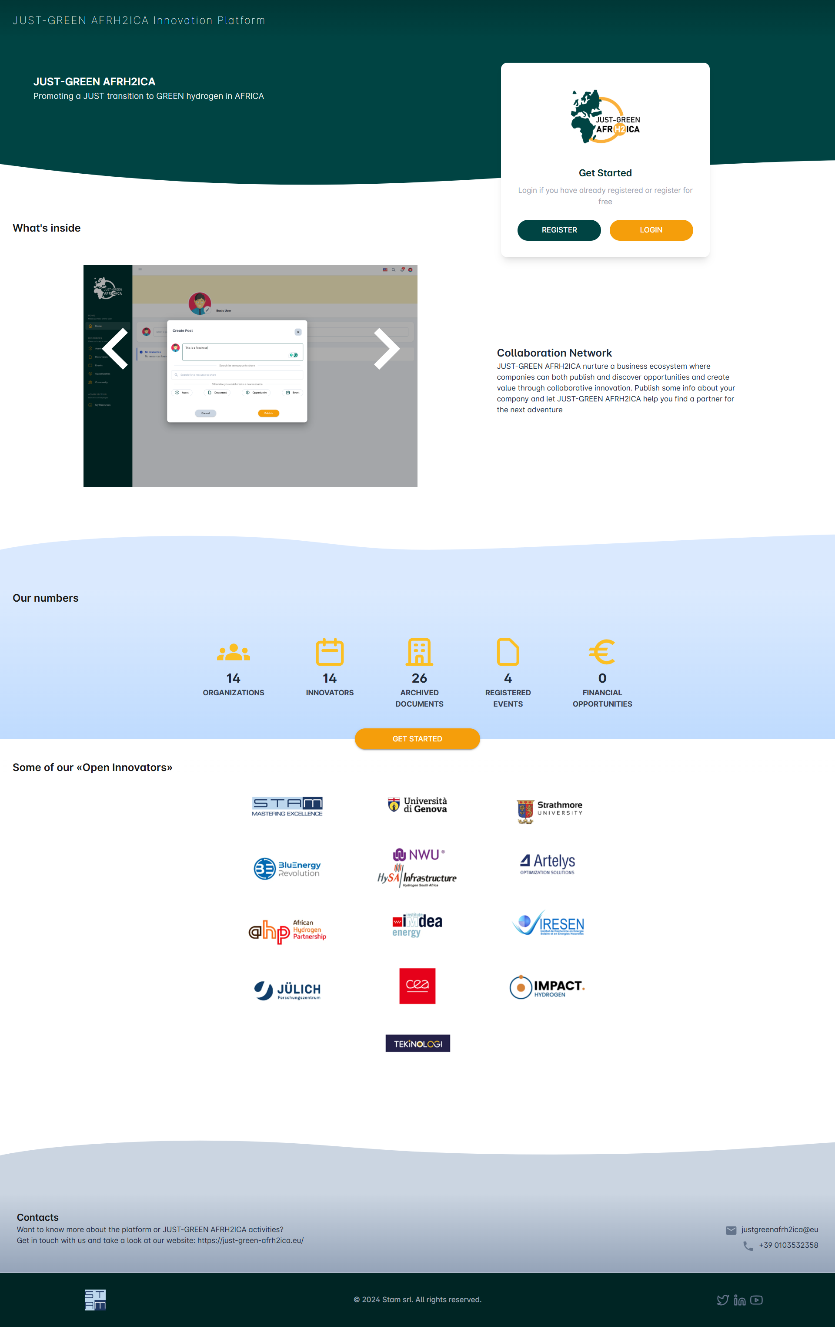
LOG-IN
LOGIN PAGE
After clicking on the link https://jga.stamtech.dev/ , users are redirected to the platform login page where they can:
Click on “Login” to access the platform, if already registered
Click on “Register” to register on the platform
View the “What’s inside” banner with an introductory of the platform contents
View the “Our Numbers” summary dashboard and click on “Let's Get Started” to be redirected to the login page
View the banner with Some of our “Open Innovators”
3

Slide 4
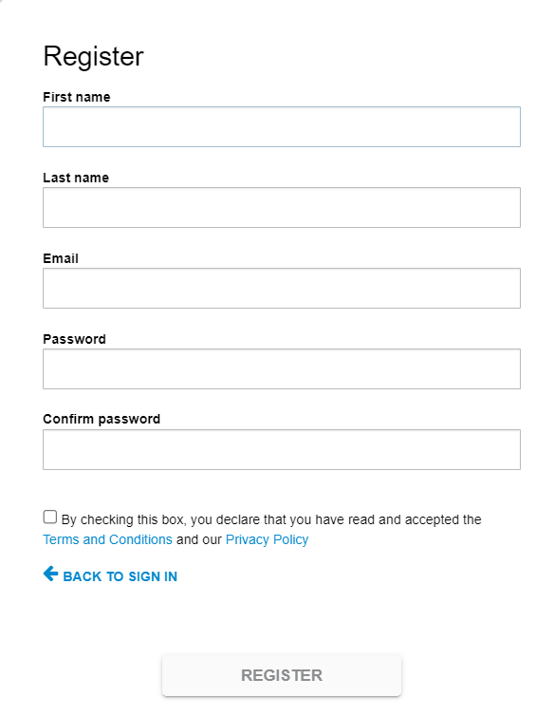
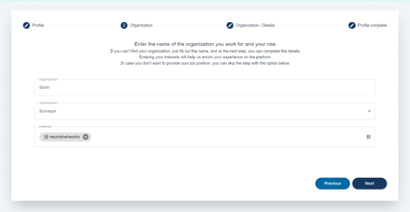
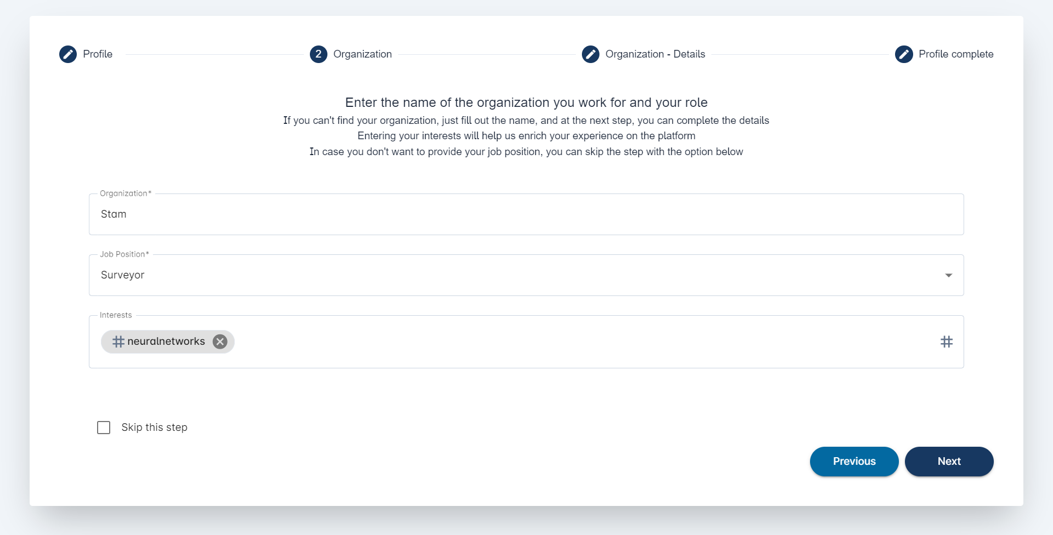
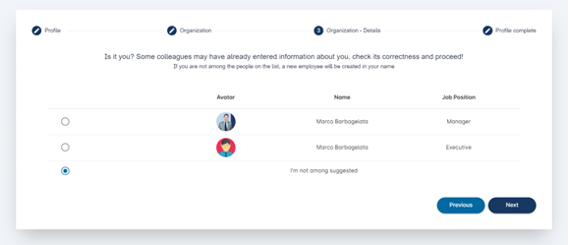
REGISTRATION
REGISTRATION
When users click on the button « Register », they visualize the modal where they can fill in their data to complete the registration
After entering their data, the users click on "Register" and they receive an email (on the indicated mailbox) with the link they must click to confirm the registration
When clicking on the link received via mail, users are redirect to the User profile set up page where they can enter their data to complete the platform registration.
In this section users have the possibility of:
Selecting their Organization by choosing from those already surveyed or creating it from the beginning
Express their interests through the field “Tags”
When compiling the organization information, users can either select one of the already existing organizations or add a new one. In case of a new organization, the user is redirected to the “Organization – Details” page to provide additional information and he becomes the owner of the newly created organization.
Finally, users are notified that some colleagues may have already entered their information; hence they are invited to check its correctness and, if they are not among the people on the list, a new employee will be created in their name.
4

Slide 5
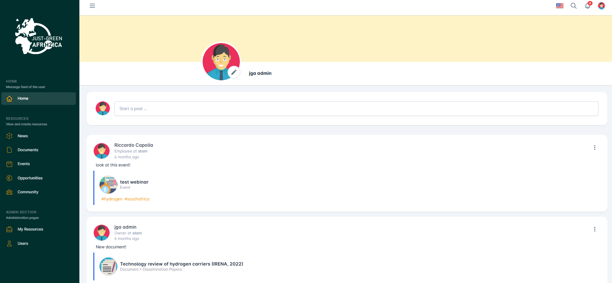
HOMEPAGE
HOMEPAGE
After logging in the platform, the user lands on the homepage where the following elements are displayed:
Platform logo
Navigation menu
Name and profile picture, with the possibility to change it
Section dedicated to the Posts creation and exhibition. The first half of the page is populated with the latest contents according to the user's interests (tags); while the second half is populated with content unrelated to the user's interests. Upon clicking on the single post, the user is redirected to the resource detail page
The following icons:
  Flag: to switch the platform language
  Magnifier: to search for tags associated to resources published in the homepage
  Bell: Shows notifications received by users
  User profile image: Links to the user's profile and allows logout
Functionality to edit and delete posts. Available only to users with the appropriate permissions
5

Slide 6
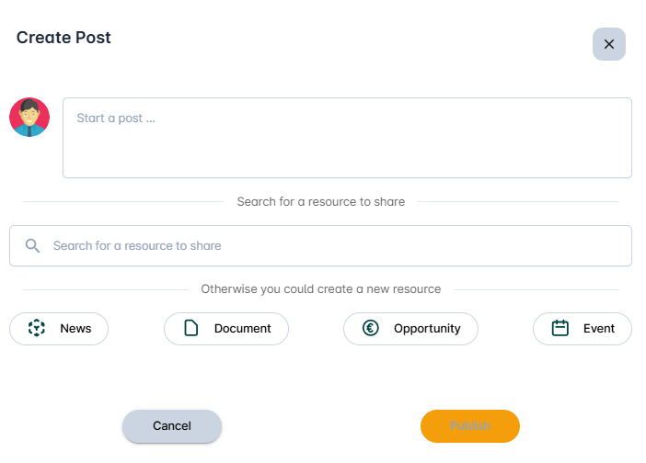
POST CREATION
POST CREATION
When users click on “Create post”, they visualize the dedicated dialog where they can:
Write the post description
Search for a resource to share by writing the name of the resource
6

Slide 7
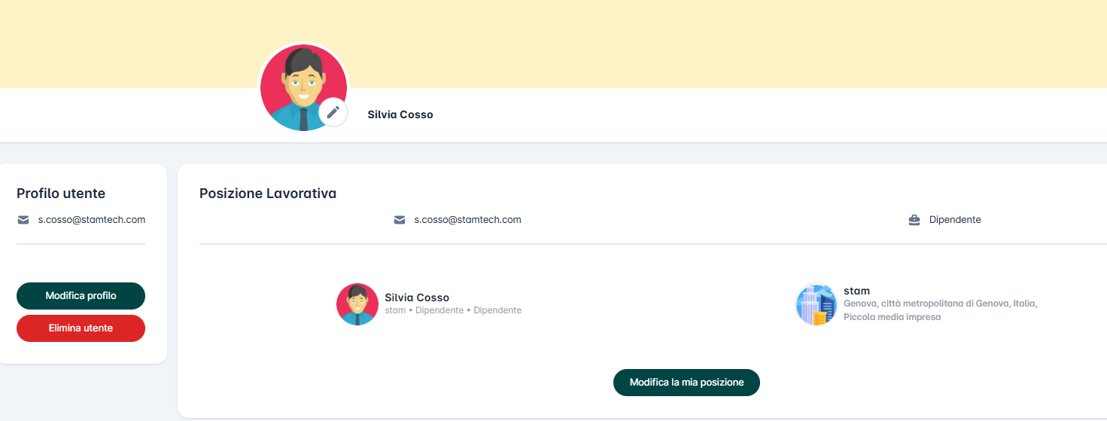
USER PROFILE
USER PROFILE
When users navigate the homepage and click on the profile icon (on the top right side of the page), they are redirected to the profile section.
In this section they can:
Click on “Edit user profile” which redirects users to the dialog with their profile information
Click on “Delete User”: if users click this button, they visualize the delete confirmation pop-up
Click on the name of the Employee to be redirected to the detail page of the employee
Click on the name of their Organization to be redirected to the detail page of the organization
Click on “Edit my job position” which redirects users to the creation page of the employee. The page is prefilled with the values entered in the registration phase, and users can modify these values
In this section, users visualize also the User profile information and the Job position of the employee
7

Slide 8
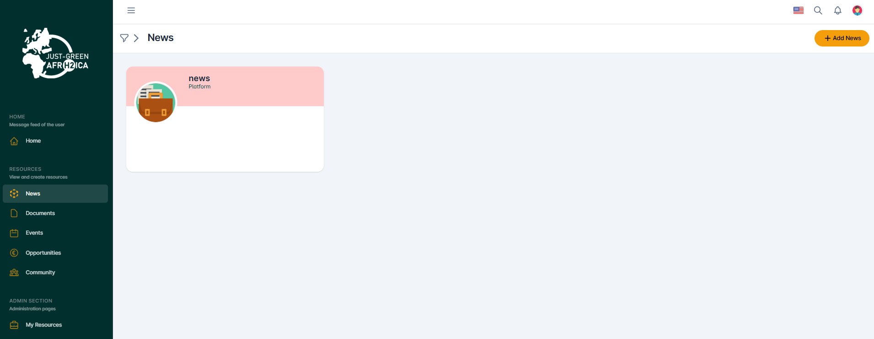
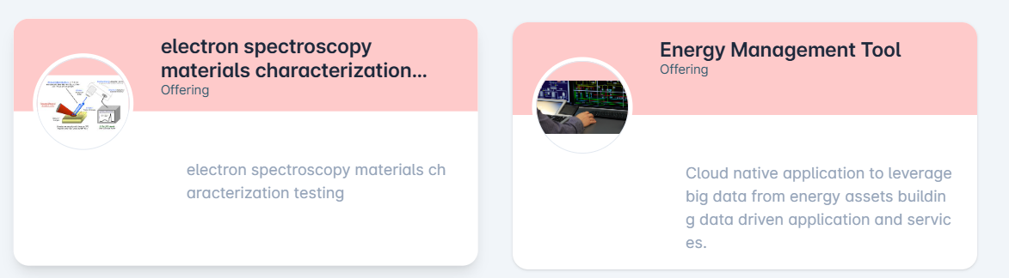
RESOURCES – NEWS (1/2)
NEWS
After clicking on «News» in the navigation menu, users are redirected to the section dedicated to News, where:
Admin users can create, read, update, delete all resources and have administrative powers over them
Standard users can create, read, update, delete only their own resources and have administrative powers over them
By clicking on the filter icon users can search for News using keywords, tags and filters
Upon clicking on the card of a News, users are redirected to the detail page of the News where they can modify, delete and update the News according to the permissions associated with their user
To create a new News, users click on «Add News». After that, they visualize the dialog with the information to be entered to create the News
8

Slide 9
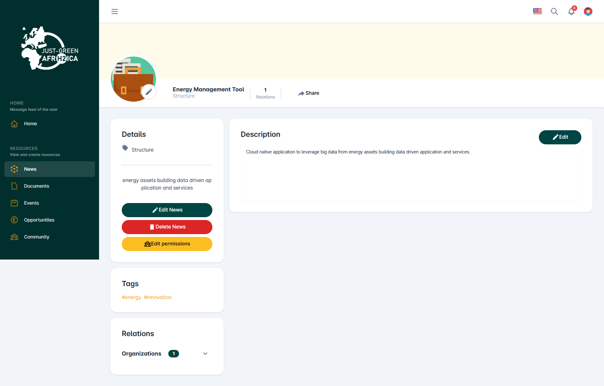
RESOURCES – NEWS (2/2)
NEWS– DETAIL PAGE
In the News detail page users visualize the following elements:
Image and name of the News, number of relationships and «Share» button to create and share a post about the News itself
Box with the Actions:
  Edit News : button which redirects users to the creation page pre-populated with the values ​​previously entered
  Delete News : button which redirects users to the creation page pre-populated with the values ​​previously entered
  Edit permissions: button which allows users to assign or modify the owner of the resources, and to assign modification permissions to other users
Details of the News
Box with the additional description related to the News
Box with tags (interests) entered by users
Box with the News relations with other resources
9

Slide 10
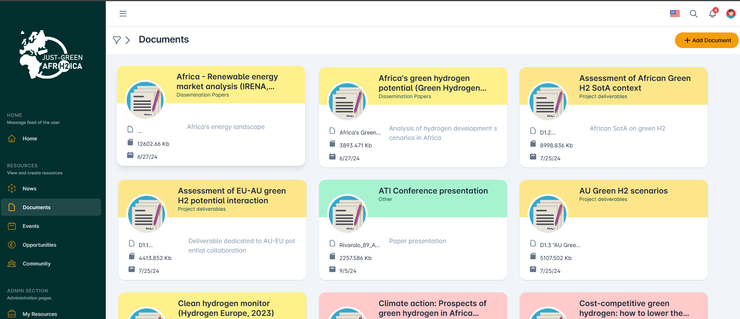
RESOURCES – DOCUMENTS (1/2)
DOCUMENTS
After clicking on «Documents» in the navigation menu, users are redirected to the section dedicated to Documents, where:
Admin users can create, read, update, delete all resources and have administrative powers over them
Standard users can create, read, update, delete only their own resources and have administrative powers over them
Users with the "Visitor" role do not have any permissions
By clicking on the filter icon users can search for Documents using keywords, tags and filters
Upon clicking on the card of a Document, users are redirected to the detail page of the Document where they can modify, delete etc. according to the permissions associated with their user.
To create a new Document, users click on «Add Document», and they visualize the screen with the information to be entered to create the Document
10

Slide 11
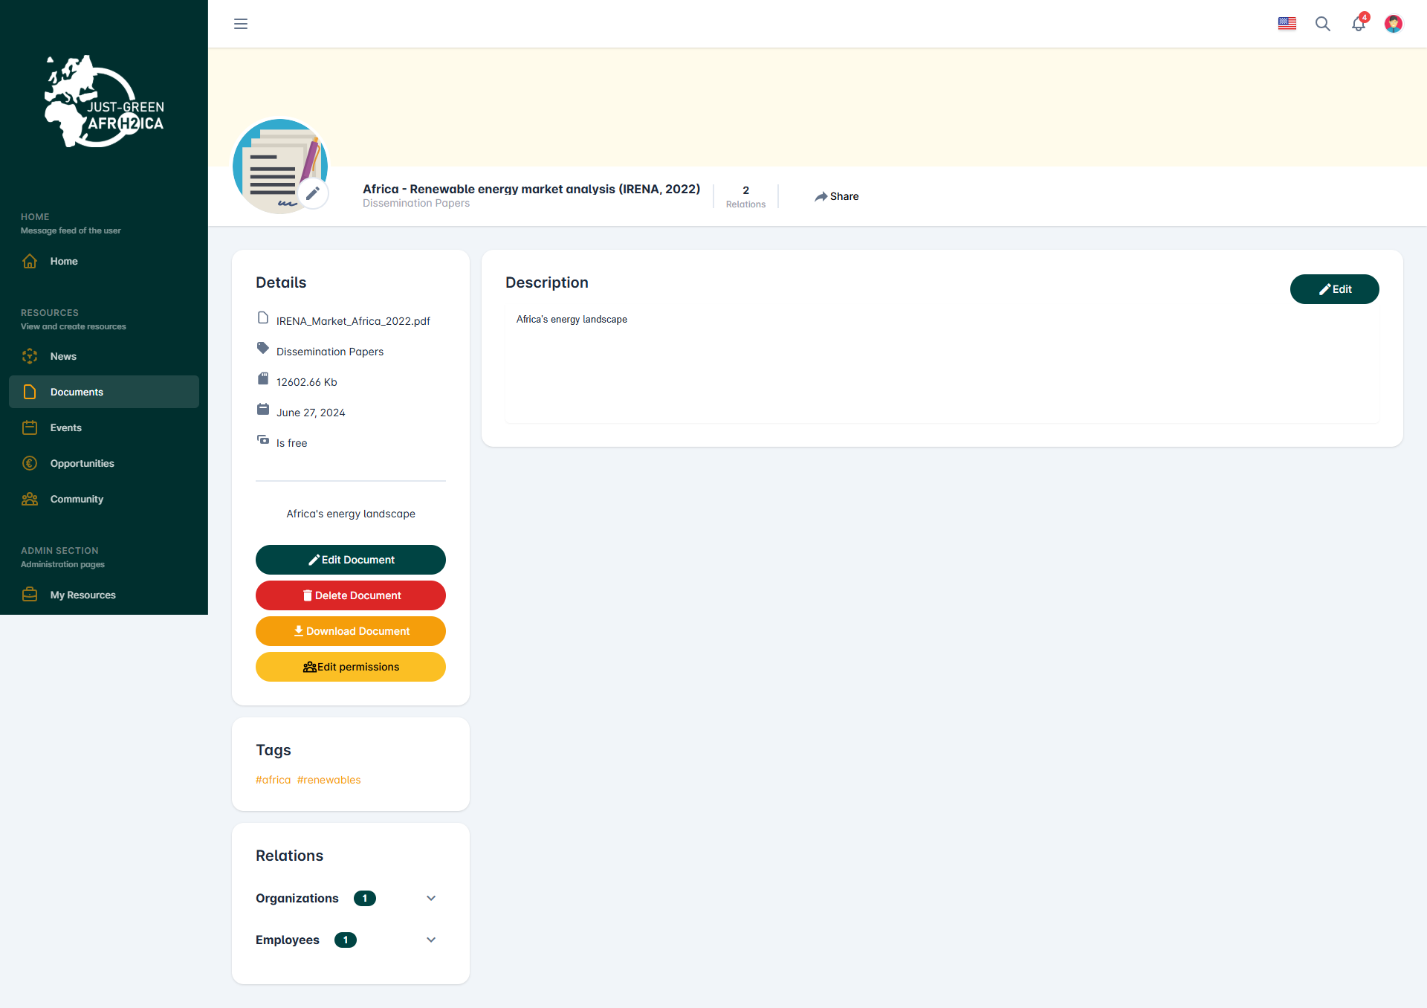
RESOURCES – DOCUMENTS (2/2)
DOCUMENTS – DETAIL PAGE
In the Documents detail page users visualize the following elements:
Image and name of the Document, number of relationships and «Share» button to create and share a post about the Document itself
Box with the Actions:
  Download Document: to download the file
  Edit Document: button which redirects users to the creation page pre-populated with the values ​​previously entered
  Delete Document: button which redirects users to the creation page pre-populated with the values ​​previously entered
  Edit permissions : button which allows users to assign or modify the owner of the resources, and to assign modification permissions to other users
Section with the Document details (type, external links, dates, description etc.)
Box with additional description related to the Document
Box with tags (interests) entered by users
Box with the Document's relationships with other resources
11

Slide 12
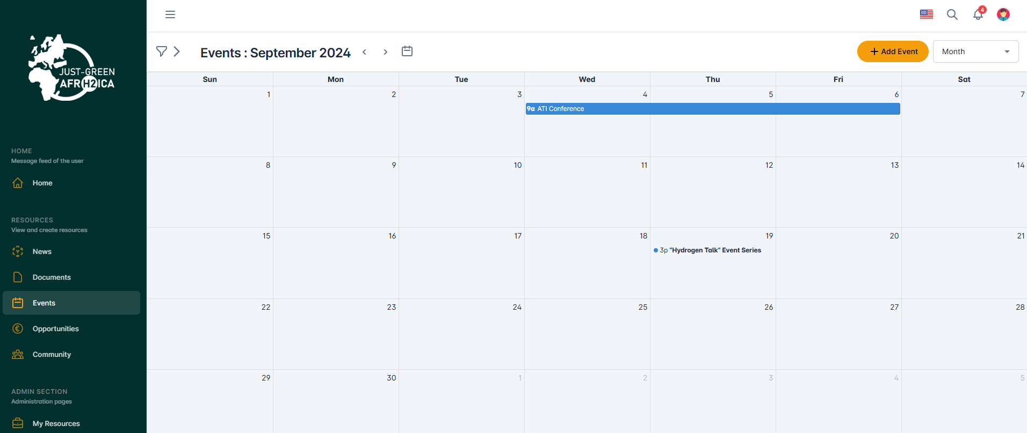
RESOURCES – EVENTS (1/2)
EVENTS
After clicking on «Events» in the navigation menu, users are redirected to the section dedicated to Events, where:
Admin users can create, read, update, delete all resources and have administrative powers over them
Standard users can create, read, update, delete only their own resources and have administrative powers over them
By clicking on the filter icon users can search for Events using keywords, tags and filters
Upon clicking on the card of an Event, users are redirected to the detail page of the Event where they can modify, delete and update the Event according to the permissions associated with their user
To create a new Event, users click on «Add », and they visualize the screen with the information to be entered to create the Event
By clicking on the box “schedule” users can change the visualization of the Events, deciding between agenda or calendar visualization
12

Slide 13
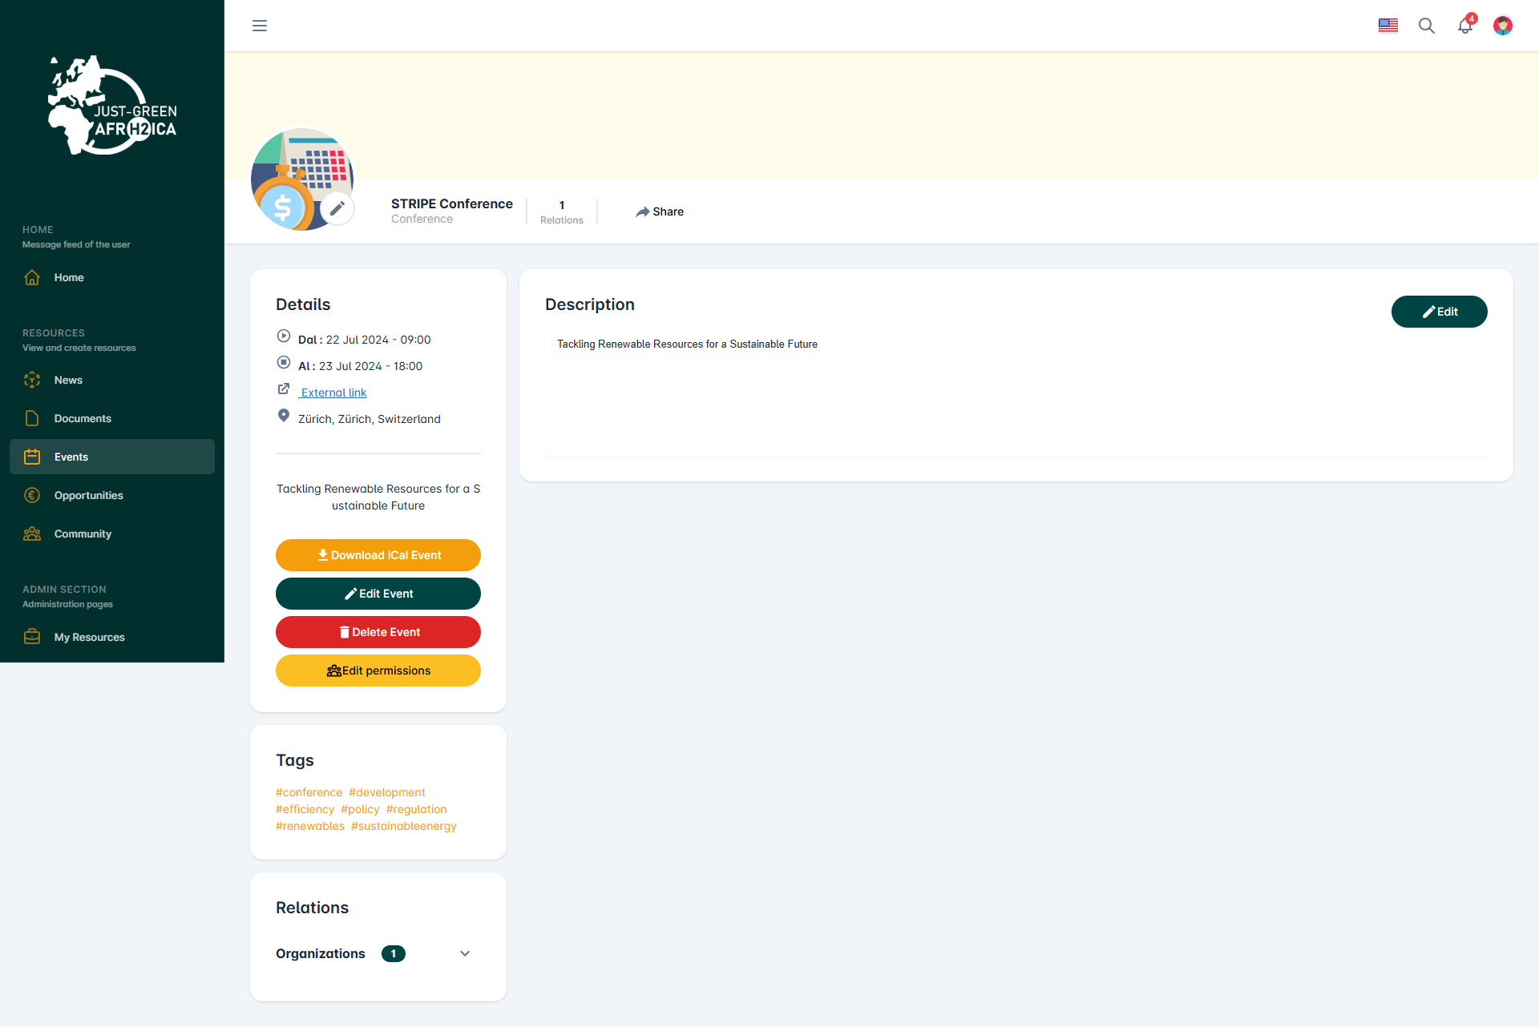
RESOURCES – EVENTS (2/2)
EVENTS– DETAIL PAGE
In the Event detail page users visualize the following elements:
Image and name of the Event, number of relationships and «Share» button to create and share a post about the Event itself
Box with the Actions:
  Download iCal Event : button to download the event calendar
  Edit Event: button which redirects users to the creation page pre-populated with the values ​​previously entered
  Delete Event: button which redirects users to the creation page pre-populated with the values ​​previously entered
  Edit permissions: button which allows users to assign or modify the owner of the resources, and to assign modification permissions to other users
Details of the Event
Box with the additional description related to the Event
Box with tags (interests) entered by users
Box with the Event’s relations with other resources
13

Slide 14
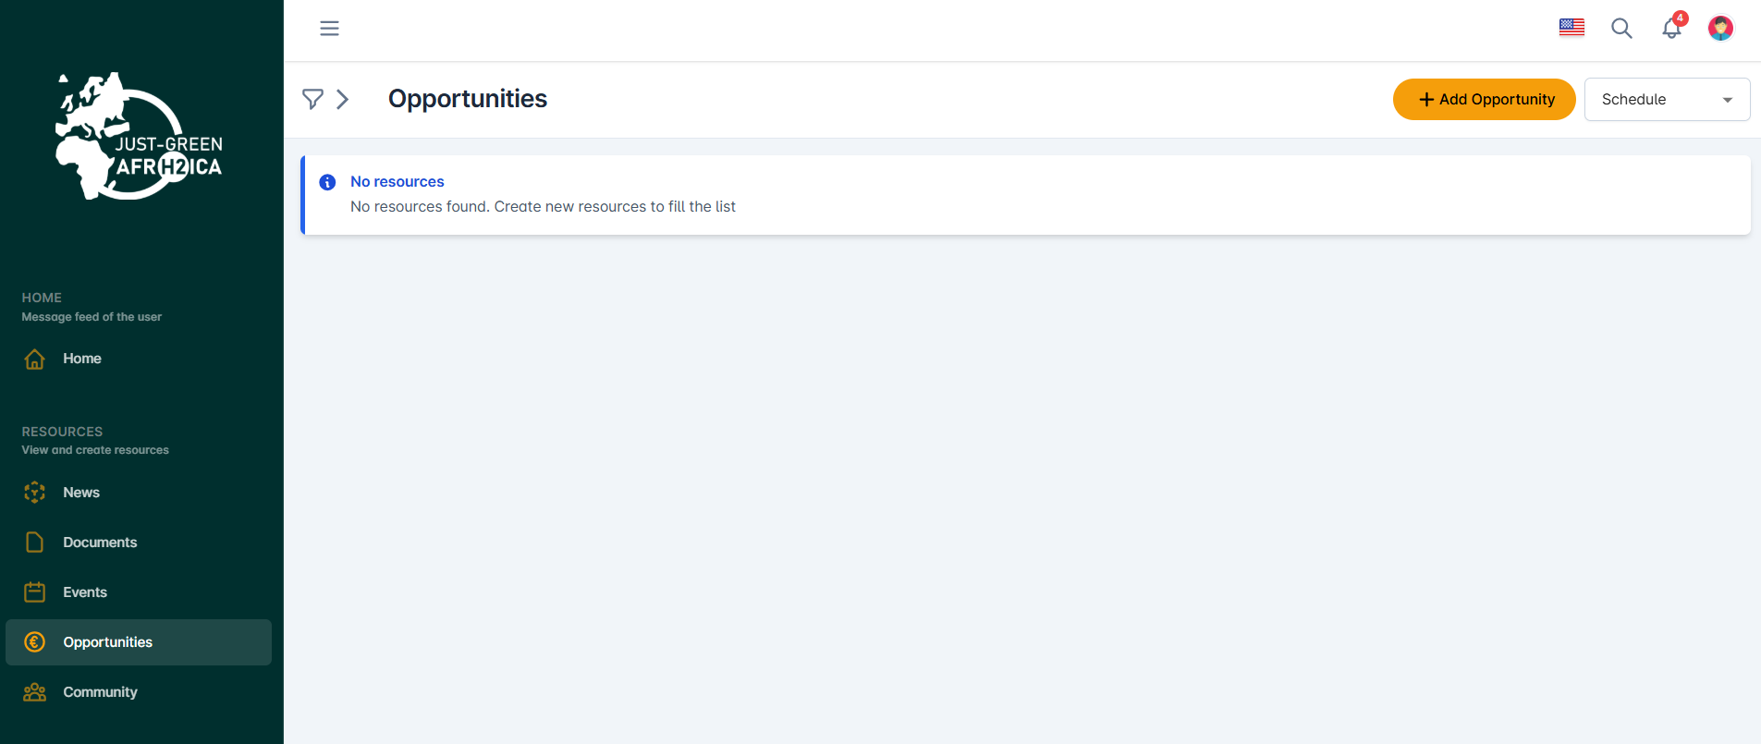
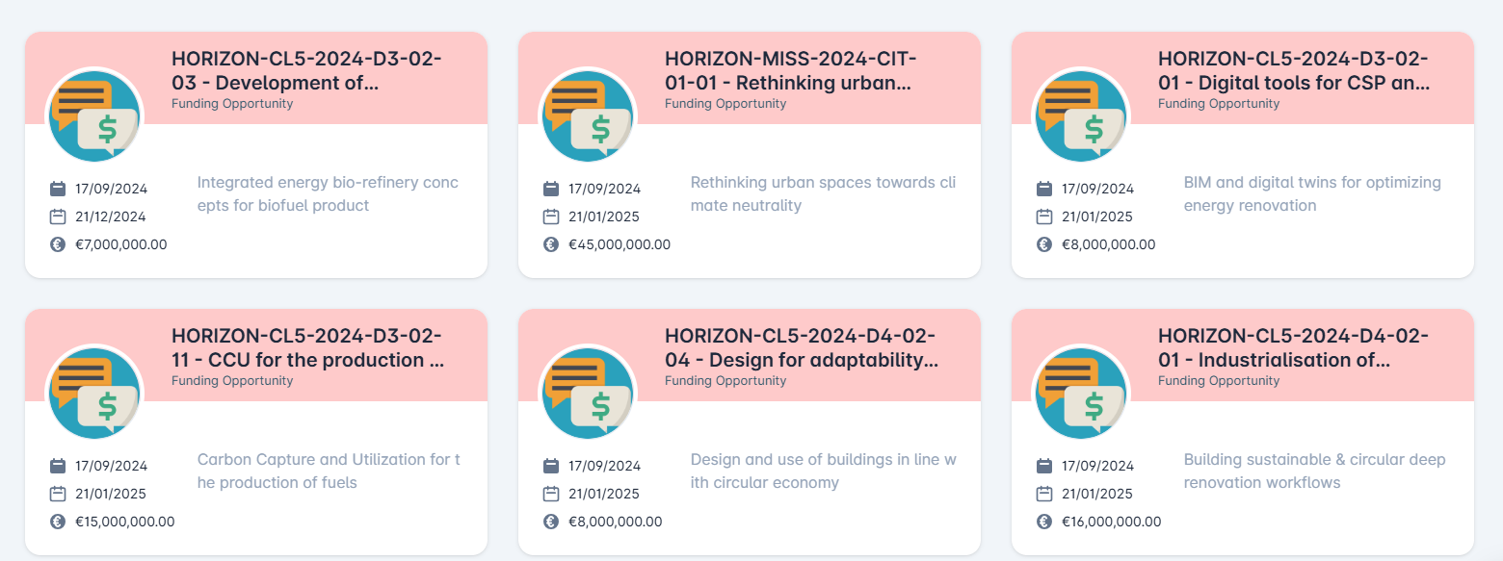
RESOURCES –OPPORTUNITIES (1/2)
OPPORTUNITIES
After clicking on «Opportunities» in the navigation menu, users are redirected to the section dedicated to the Opportunities, where:
Admin users can create, read, update, delete all resources and have administrative powers over them
Standard users can create, read, update, delete only their own resources and have administrative powers over them
By clicking on the filter icon users can search for Opportunities using keywords, tags and filters
Upon clicking on the card of an Opportunity, users are redirected to the detail page of the Opportunity where they can modify, delete and update the Opportunity according to the permissions associated with their user
To create a new Opportunity, users click on «Add », and select the opportunity type they want to create. After that, they visualize the screen with the information to be entered to create the Opportunity
By clicking on the box “schedule” users can change the visualization of the funding opportunities, deciding between agenda or calendar visualization
14

Slide 15
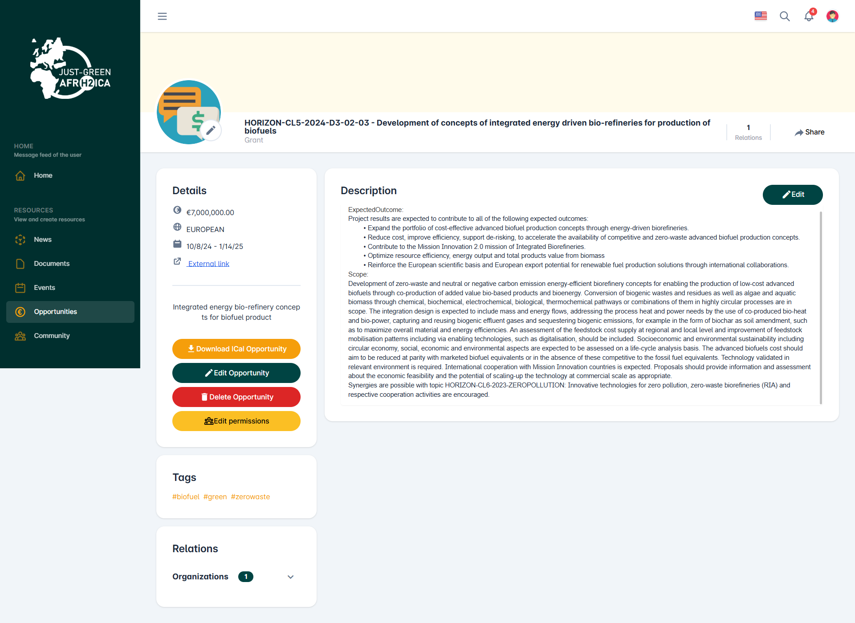
RESOURCES –OPPORTUNITIES (2/2)
OPPORTUNITIES – DETAIL PAGE
In the Opportunities detail page users visualize the following elements:
Image and name of the Opportunity, number of relationships and «Share» button to create and share a post about the Opportunity itself
Box with the Actions:
  Download iCal Opportunity : button to download the event calendar
  Edit Opportunity: button which redirects users to the creation page pre-populated with the values ​​previously entered
  Delete Opportunity: button which redirects users to the creation page pre-populated with the values ​​previously entered
  Edit permissions: button which allows users to assign or modify the owner of the resources, and to assign modification permissions to other users
Details of the Opportunity
Box with the additional description related to the Opportunity
Box with tags (interests) entered by users
Box with the Opportunity's relations with other resources
15

Slide 16
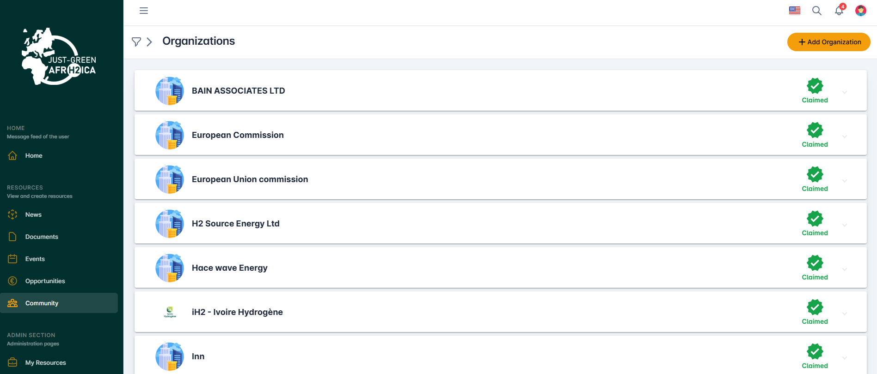
RESOURCES - ORGANIZATIONS (1/2)
ORGANIZATIONS
After clicking on «Organization» in the navigation menu, users are redirected to the section dedicated to Organizations, where:
Admin users can create, read, update, delete all the organizations and have administrative powers over them
Standard Users can read all the organizations and update/delete only their Organization
By clicking on the filter icon users can search for Organizations using keywords, tags and filters
Upon clicking on the card of an Organization, users are redirected to the detail page of the Organization where they can modify, delete and update the Organization according to the permissions associated with their user
To create a new Organization, users click on «Add Organization», and select the organization type they want to create. After that, they visualize the screen with the information to be entered to create the Organization
16

Slide 17
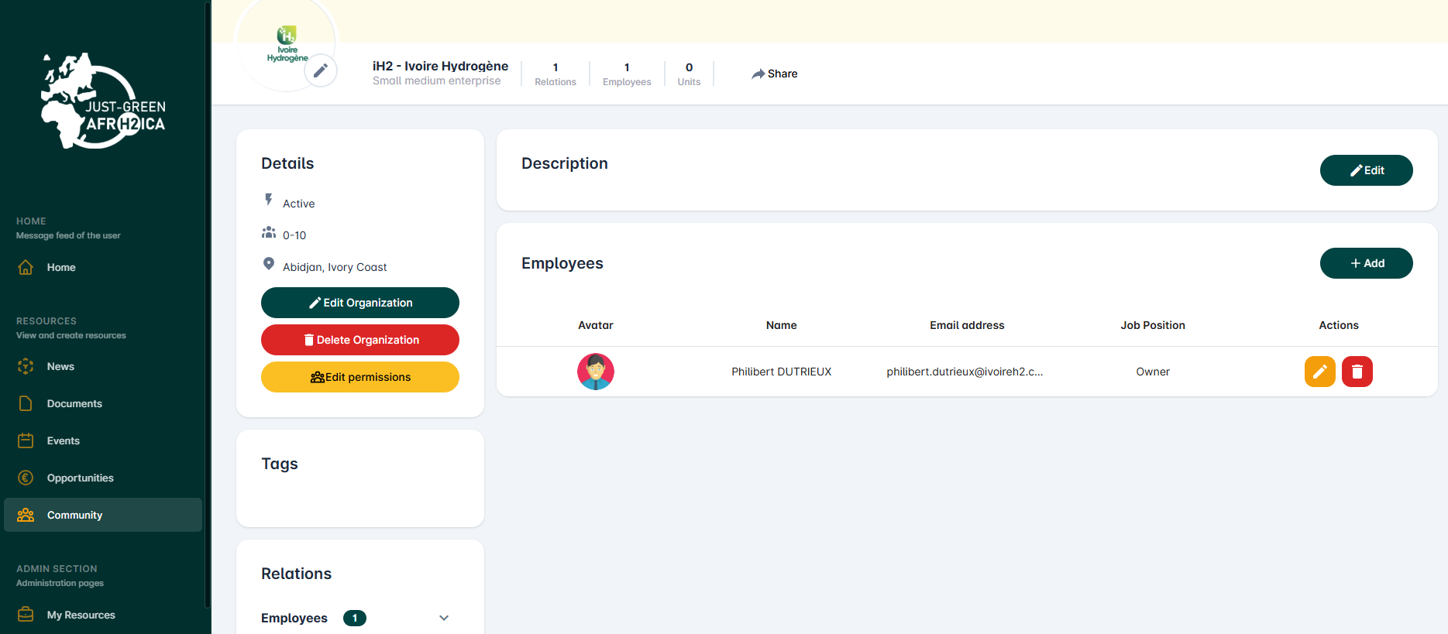
RESOURCES - ORGANIZATIONS (2/2)
ORGANIZATIONS – DETAIL PAGE
In the Organizations detail page users visualize the following elements:
Name, Profile Picture and Background Picture of the Organization, number of relationships and «Share» button to create and share a post about the Organization itself
Box with the Actions :
  Edit Organization: button which redirects users to the creation page pre-populated with the values ​​previously entered
  Delete Organization: button which redirects users to the creation page pre-populated with the values ​​previously entered
  Edit permissions: button which allows users to assign or modify the owner of the resources, and to assign modification permissions to other users
Box with Organization’s details (type, external links, dates, description etc.)
Box with additional description relating to the Organization
Box with tags (interests) entered by users
Box with the Organization's relationships with other resources
Section with the Employees related to that Organization, with the functionalities to add, modify or delete employees
17

Slide 18
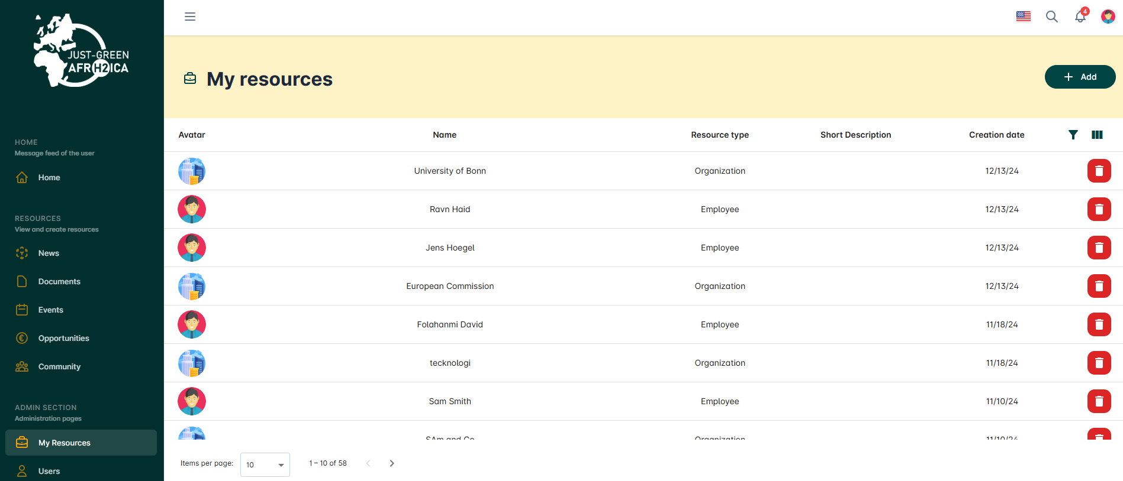
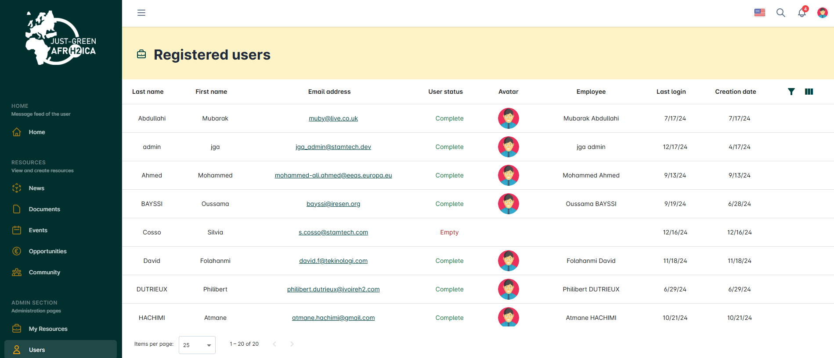
ADMINISTRATION SECTION
ADMINISTRATION SECTION
This section is dedicated to user and resource management.
In the «My resources» section all the resources are listed in detail:
Admin users can see all created resources.
Standard and Visitor users can only see the resources they have created themselves, or the resources they own
According to the permissions associated with their user account, in this section users can delete resources
In the «Registered users» section, available only to Admin Users, all registered users are shown, with the possibility of searching for users using filters and monitoring their access.
18

